Slide 1
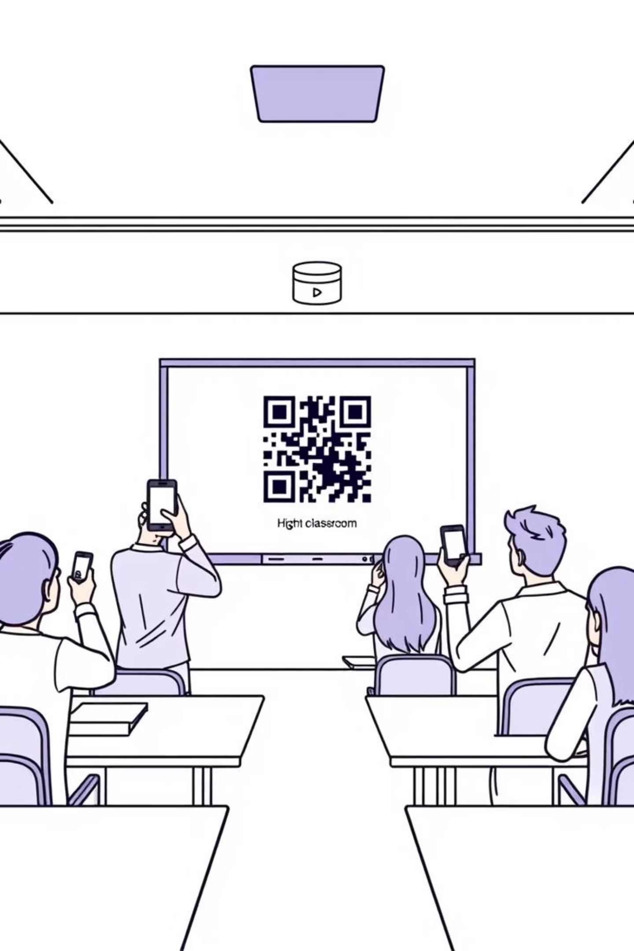
Classroom Attendance Management with QR Codes using JDBC
A Digital Solution for Efficient Attendance Tracking
Presented by: S Dinesh Ram & M Logesh

Slide 2

Introduction: Revolutionizing Attendance
Traditional attendance methods are plagued by inefficiency and inaccuracies. Manual roll calls are time-consuming, prone to human errors, and susceptible to proxy attendance. These challenges disrupt class flow and undermine data reliability.
Our solution leverages the power of QR codes for rapid, automated scanning, combined with JDBC for seamless, robust data management. This approach ensures an accurate, fast, and efficient attendance system.
Why Automation?
Automating attendance frees up valuable class time, provides real-time data, and enhances overall administrative efficiency.

Slide 3
Core Objectives: Precision and Efficiency
Our primary goals are to streamline attendance processes and enhance data integrity:
Automate Attendance
Database Integration
Implement a system for rapid, hands-free attendance recording using QR code scanning.
Utilize JDBC to connect the Java application with a robust database for secure storage and retrieval of attendance records.
Reduce Errors & Improve Accuracy
Instant Reporting
Minimize manual data entry mistakes and eliminate proxy attendance issues.
Enable the generation of real-time attendance reports for timely monitoring and analysis.

Slide 4
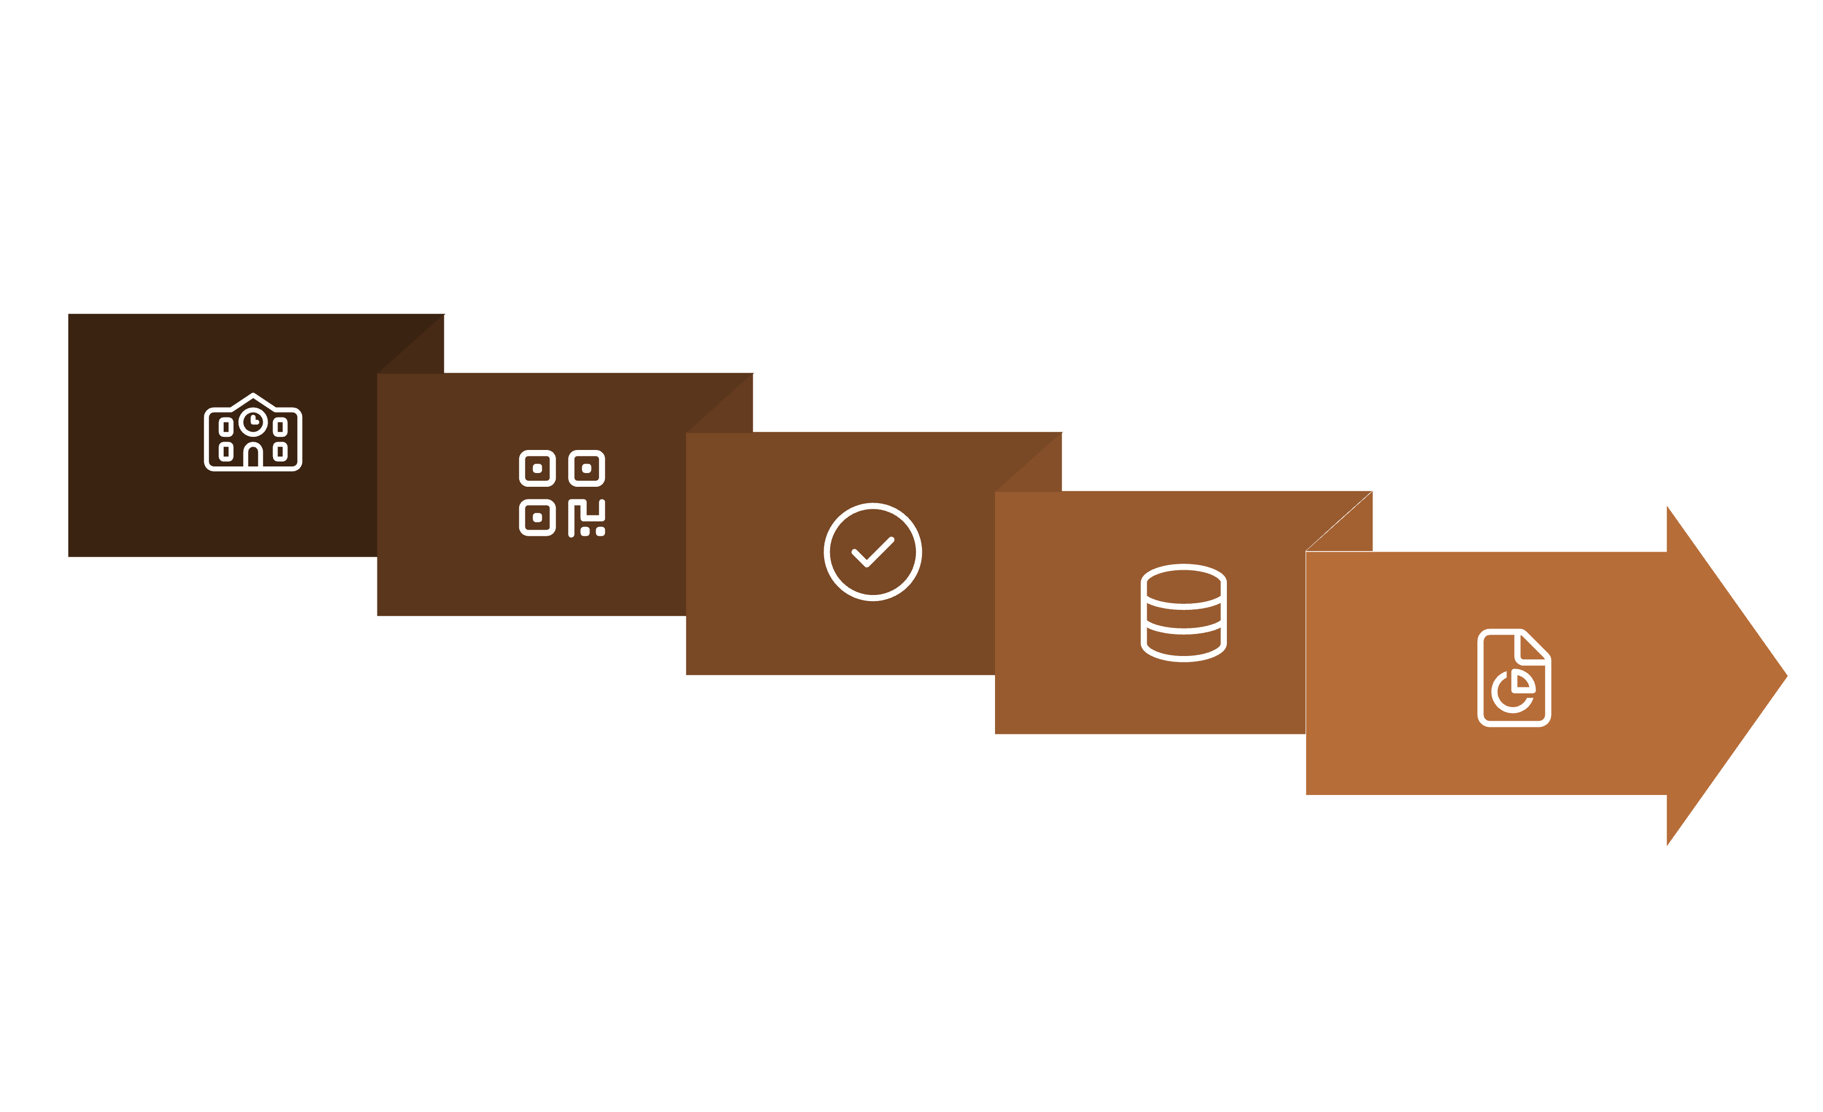





System Overview: The Flow of Data
The system follows a clear, efficient pipeline from student interaction to data reporting.
Student
Attendance Recorded
Report Generated
Scans QR
Data Stored
Students initiate the process by scanning their unique QR codes. This action triggers the attendance record, which is then securely stored in the database. Authorized personnel can then generate detailed reports for analysis.

Slide 5





Key Technologies Driving the System
Our system is built on a foundation of proven and reliable technologies to ensure seamless operation and robust performance.
QR Code System
Database Management
JDBC Connectivity
Leveraging Java libraries like ZXing for efficient QR code generation and scanning capabilities.
MySQL serves as the robust backend for storing all attendance records and user data.
JDBC (Java Database Connectivity) facilitates the crucial link between our Java application and the MySQL database.
Development Environment
Hardware Interaction
Eclipse IDE provides a comprehensive and efficient platform for developing the application.
Attendance capture relies on standard smartphones or dedicated QR scanners.

Slide 6
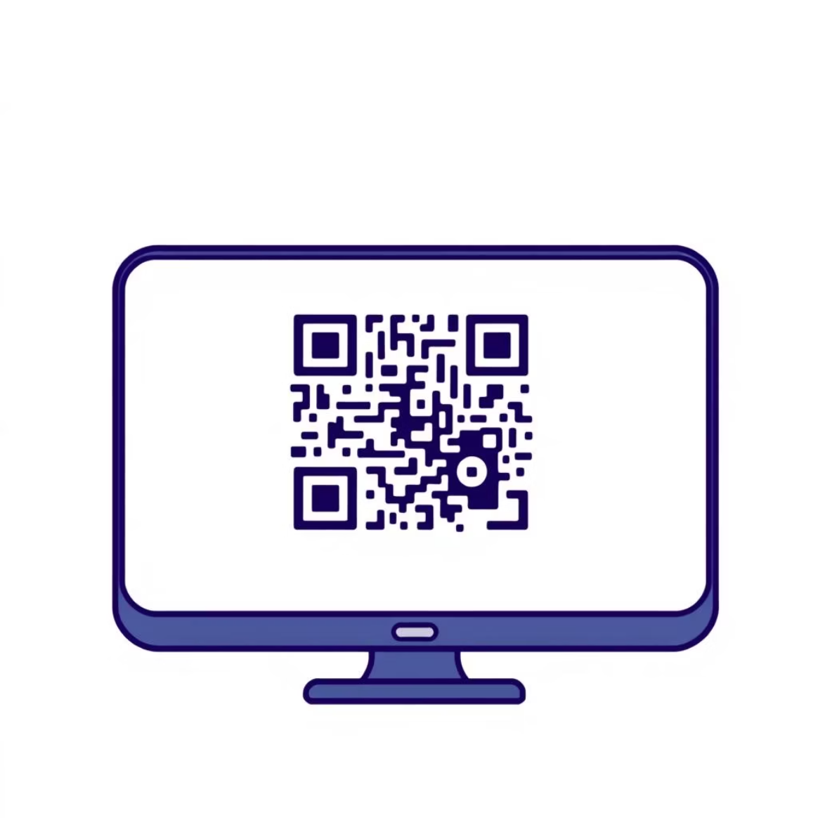
QR Code Mechanics: Your Digital ID
Each QR code acts as a secure, unique identifier, simplifying the attendance process.
Unique Identification: Every student and staff member receives a distinct QR code.
Encoded Details: Each code securely contains essential information, such as Student ID, name, and Staff ID.
Instant Data Transfer: Upon scanning, the encoded details are decoded and immediately transmitted to the database for recording.
This method ensures a fast, accurate, and fraud-resistant attendance capture, replacing cumbersome manual procedures.

Slide 7
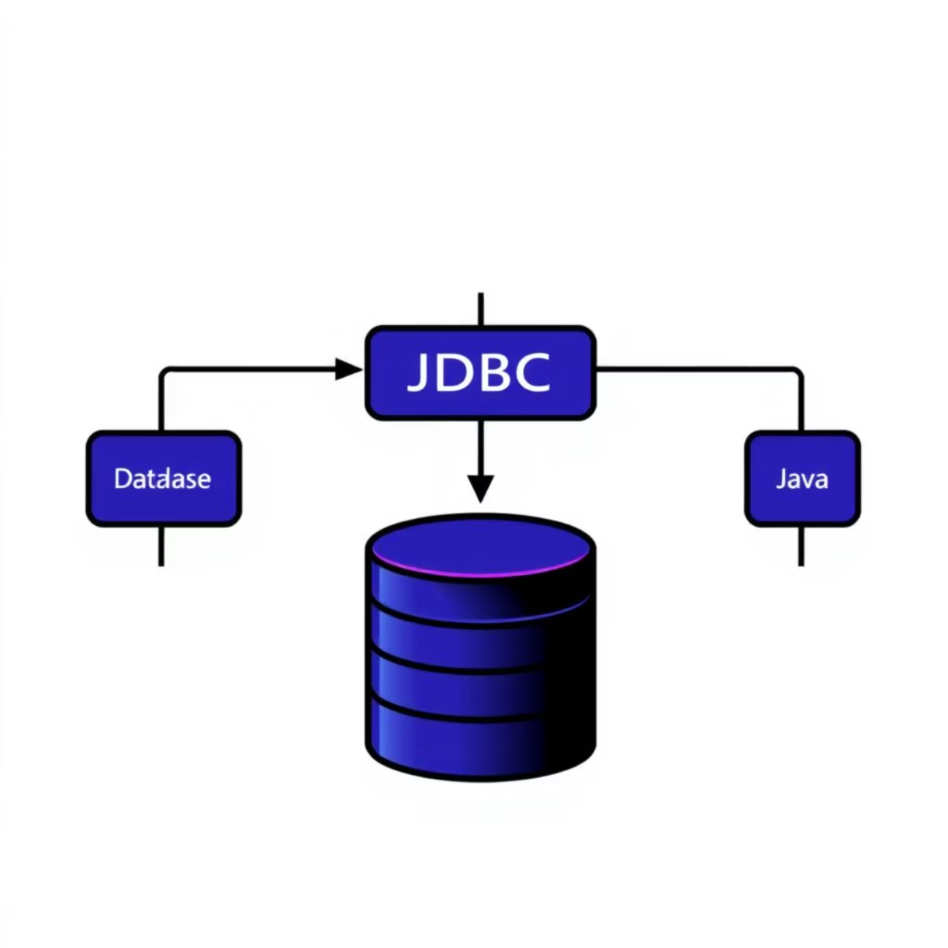
JDBC: The Bridge to Your Data
Java Database Connectivity (JDBC) is the cornerstone of our system's data interactions, enabling seamless communication between our Java application and the MySQL database.
What is JDBC?
"JDBC is a Java API that enables Java applications to interact with various database management systems (DBMS) using standard SQL queries."
Role in this project:
Connection: Establishes and manages the link to the MySQL database.
Data Operations: Facilitates inserting new attendance records, updating existing ones, and retrieving historical data.
Reporting: Powers the generation of comprehensive attendance reports directly from the database.

Slide 8
Database Design: Structured for Efficiency
A well-structured database is crucial for efficient storage and retrieval of attendance information. We utilize two primary tables to manage student and staff data, ensuring data integrity and ease of access.
Students Table
Staff Table
student_id
Unique identifier for each student (Primary Key)
staff_id
Unique identifier for each staff member (Primary Key)
name
Full name of the student
name
Full name of the staff member
Additional tables will manage attendance records, linking student and staff IDs with timestamps and lecture details.

Slide 9


Conclusion & Future Vision
Our QR Code-based attendance system, powered by JDBC, provides a reliable, fast, and accurate solution for modern classroom management. It streamlines operations and minimizes human error.
Future Enhancements:
Face Recognition
Cloud Storage
Mobile App Support
Integrate AI-driven facial recognition for enhanced security.
Migrate data to cloud platforms for ubiquitous access and scalability.
Develop dedicated mobile applications for both students and instructors.
Thank You!
Questions?

